Slide 1
Delen Team Six Consulting
Predictive Analytics MSIS 5633 - Term Project Report Crash Report Sampling System – 2015 to 2019
Ashish Kumar Pampana
Jay West
Josh Basquez
Krishna Kurakula Thirumala

Slide 2
Executive Summary
DTSC - Delen Team Six Consulting LLC
provides detailed consulting advice to state and local governments
uses various data sources to provide business intelligence reports
data driven analytical studies
predictive models using predictive modeling techniques.

Slide 3
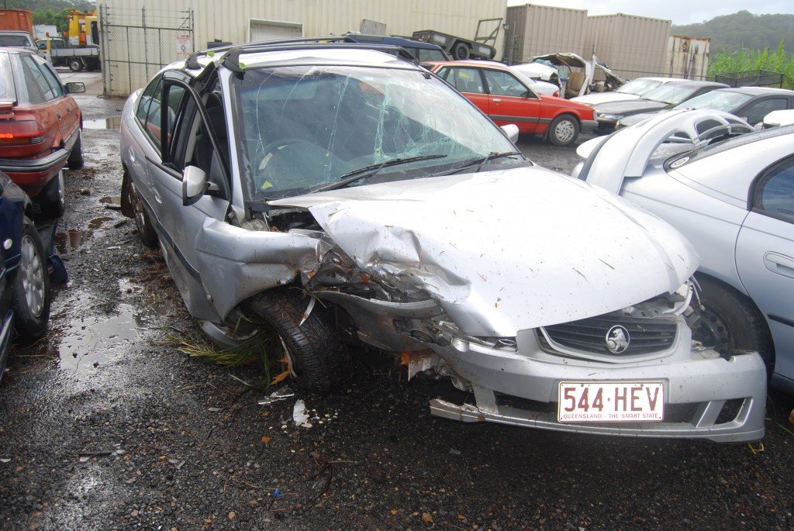
Business Understanding
Objectives
Predict ‘Injury Severity’ in auto mobile accidents
Preventing human tolls and economic loss
In the third quarter of 2021,
280 M cars are on the road (230M/50M)
In 2019, 4.8M in property damage.

Slide 4
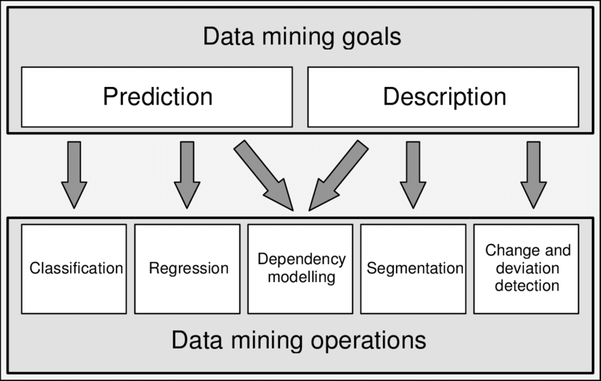
Business Understanding
Data Mining Goals
Prediction and description to optimize the accuracy
Reduce and prevent human tolls and improve highway safety measures

Slide 5
Data Understanding
The four data files were selected and used in this study:
Accident Data: Information contains crash characteristics and environment conditions.
Vehicle Data: In-transit motor vehicles and the drivers of in-transport motor vehicles involved in the crash.
Person Data: Individuals involved only in the crash with motorists. No motorists were included in this study.
Distract Data: Information contains driver distractions.
Data Characteristics:
Data Table | Total Records | No. of Variables | Unique Identifiers
Accident | 54,409 | 50 | CASENUM.
Vehicle | 96,717 | 90 | CASENUM & VEH_NO.
Person | 135,410 | 56 | CASENUM, VEH_NO & PER_NO.
Distract | 96,751 | 11 | CASENUM, VEH_NO & MDRDSTRD.
The unique identifiers were used to join the four data files with the help of entity relationship model provided for this study.

Slide 6
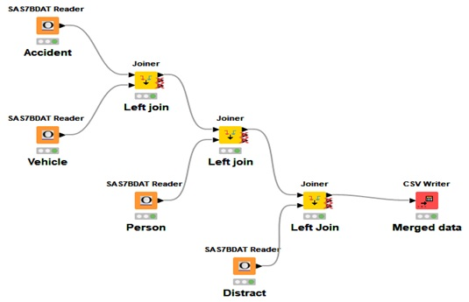
Data Preparation - Joining
Data Joining:
The data used in this study are in .sas7bdat format.
The four data tables were configured in KNIME using ‘SAS7BDAT Reader’ node.
The ‘Joiner’ node was used to join the tables using Left-Join.
The accident and vehicle tables were linked together with primary key "CASENUM".
The preceding join's output is then joined with the person table with primary keys “CASENUM” and “VEH_NO.”
Finally, using the prior matching criteria, the output of the previous join is merged with the distract table.

Slide 7
Data preparation – Variables Selection
1. Variables that fit into categories such as technical attributes of the vehicle, environmental factors, conditions of the road, crash-related attributes, sociological attributes of a person.
2. Delete the columns with variances close to ‘0’.
3. Variable importance chart
4. Backward elimination and forward selection techniques

Slide 8
 | Variables | Data type | Values
1 | REGION | Numeric | Northeast, Midwest, South, West
2 | ALCOHOL | Numeric | Alcohol involved; No alcohol involved
3 | VE_TOTAL | Numeric | 1-199 (Number of vehicles in crash)
4 | WRK_ZONE | Numeric | Construction, Maintenance, Utility (Work zone)
5 | WEATHER | Numeric | Clear, Rain, Sleet, Snow, Fog/smog/smoke, Severe Crosswinds, Blowing Sand/soil/dirt, cloudy, blowing snow, freezing rain
6 | ROLINLOC | Numeric | No Rollover, On Roadway, On Shoulder, On Median, In Gore, On Roadside, outside of Trafficway, In Parking Lane/Zone
7 | NUMOCCS | Numeric | 1-98 (Number of occupants)
8 | P_CRASH2 | Nominal | This vehicle loss of control due to, this vehicle traveling, other motor vehicle in lane
9 | TOWED | Numeric | Towed, Not towed
10 | FIRE_EXP | Numeric | Yes, no (Whether a fire occurred in the vehicle or not)
11 | VEH_ALCH | Numeric | Alcohol involved; No alcohol involved
12 | AGE | Numeric | 1-120 (years of age)
13 | SEX | Numeric | Male, Female
14 | URBANCITY | Numeric | Urban; Rural
15 | DRUGS | Numeric | Yes, no (Drugs involvement)

Slide 9
Data preparation
16 | HOSPITAL | Numeric | Transported; Not transported; EMS air; EMS ground; Transported unknown source; Law enforcement
17 | REST_USE | Numeric | Occupant’s restraint equipment (0-29)
18 | DRINKING | Numeric | Alcohol involved; No alcohol involved
19 | BODY_TYP | Nominal | Body type of the vehicle
20 | ROLLOVER | Nominal | No rollover, rollover
21 | DEFORMED | Nominal | Major, Minor (amount of damage)
22 | SEAT_POS | Nominal | Front, second, third, trailing (seating position)
23 | REST_MIS | Nominal | Restraint system (No misuse, misuse)
24 | AIR_BAG | Nominal | Deployed, Not deployed (air bag)
25 | EJECTION | Nominal | Not ejected, ejected (person ejected/not ejected) from the vehicle
26 | INJ_SEV | Nominal | Injury Severity (High, Low)

Slide 10
Data Preparation - Steps in processing
Joiner
Data explorer
Column filter
Color manager
Row filter
Rule engine
Numeric Binner
Partitioning
Equal size sampling and smote

Slide 11





Rule Engine
EJECTION
SEAT_POS
REST_MIS
AIR_BAG
ROLLOVER

Slide 12



Rule Engine
INJ_SEV
P_CRASH2
BODY_TYP

Slide 13
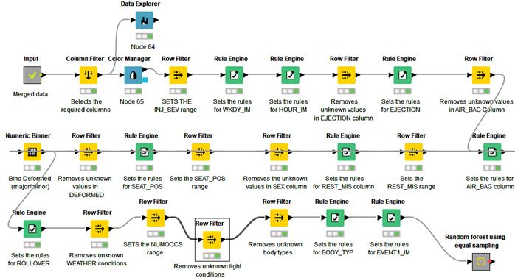

Slide 14
Modeling
Decision Trees
Logistic Regression
Random Forest
Gradient Boosted Tree
Artificial Neural Networks (ANN)

Slide 15
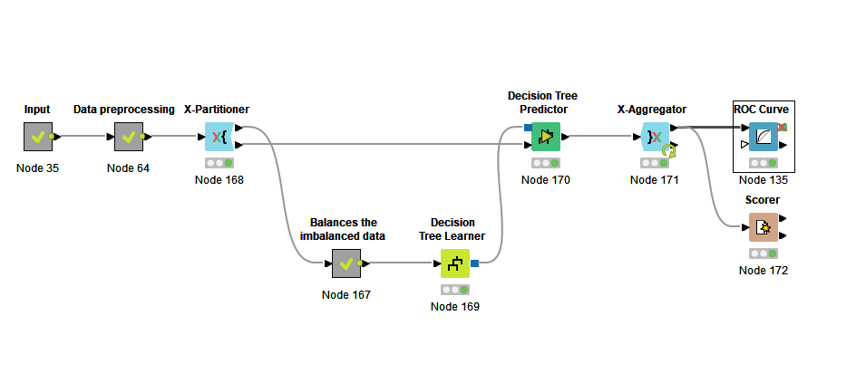

Modeling - Decision Trees Decision trees are widely used in machine learning due to its easy of interpretation. “how they do what they do”

Slide 16
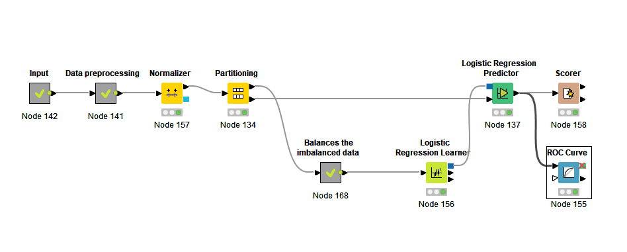
Modeling - Logistic Regression
Is a supervised learning classification algorithm
For binomial and multi-nomial classification type
Less desirable due to the restricted assumptions such as independency, normality, multi-collinearity

Slide 17
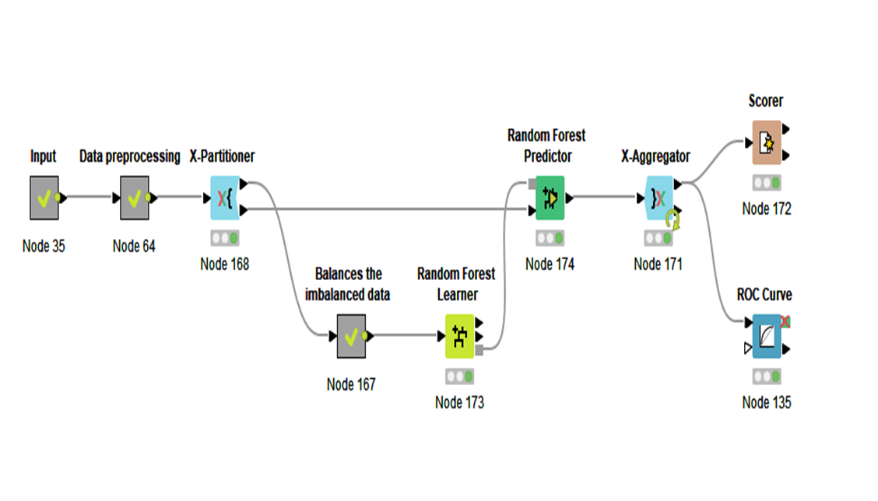
Modeling – Random Forest
Is a supervised machine learning algorithm
For regression and classification
Time-consuming, difficult to compute, and requiring a large amount of data.

Slide 18
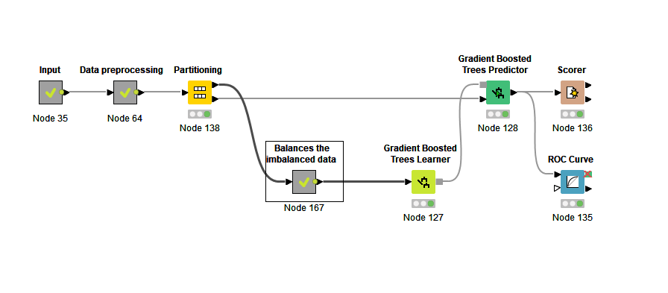
Modeling - Gradient Boosted Tree
Regression and classification
Combines separate decision trees using the boosting approach.
Similar to Random Forest
Different, gradient boosting builds one tree at a time

Slide 19
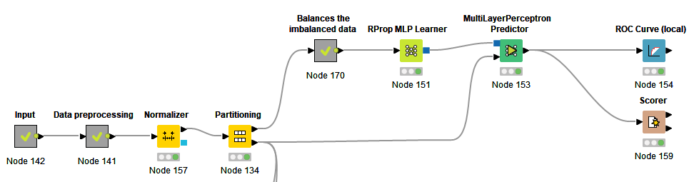
Modeling - Artificial Neural Networks (ANN):
Computational algorithms
Non-linear and complex relationships

Slide 20
Evaluation – Accuracy Table
Models | Sensitivity | Specificity | Accuracy | Area under ROC Curve
Random Forest | 0.789 | 0.589 | 75.2 | 78.9
Gradient Boosted trees | 0.724 | 0.657 | 71.2 | 77.6
Decision trees | 0.553 | 0.7 | 67.3 | 63.1
Logical regression | 0.632 | 0.702 | 64.5 | 73.9
ANN | 0.725 | 0.601 | 70.2 | 73.1

Slide 21
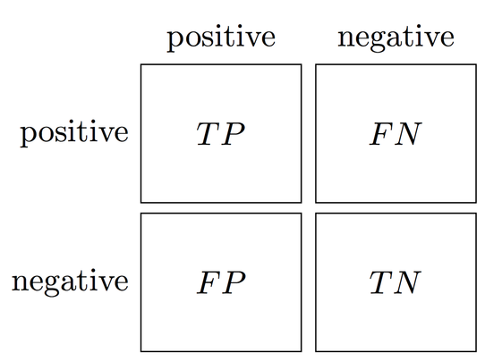
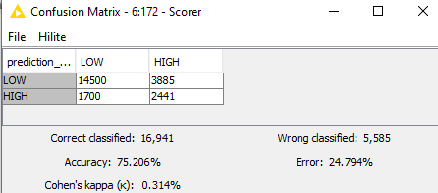




Evaluation - Confusion Matrix
Models | Sensitivity | Specificity | Accuracy | Area under ROC Curve
Random Forest | 0.789 | 0.589 | 75.2 | 78.9
Sensitivity TP / (TP + FN) = 14500 / ( 14500 + 3885) = 14500 / 18385 = 0.789
Specificity TN / ( FP + TN) = 2441 / (1700 + 2441) = 2441 / 4141 = 0.589

Slide 22
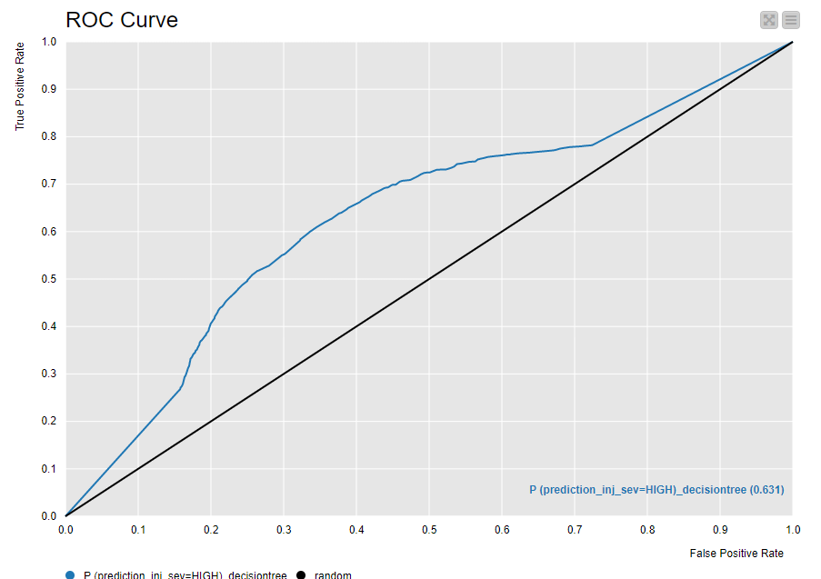
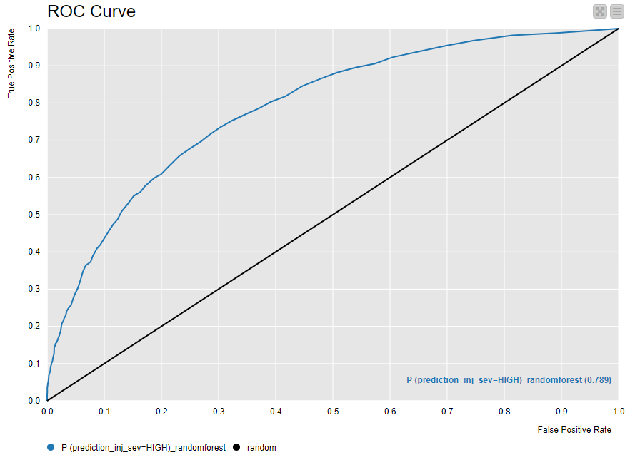

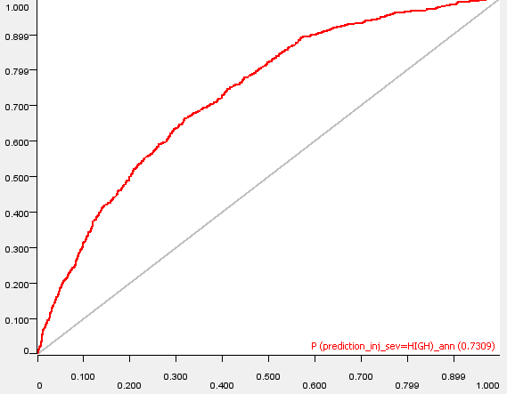
Evaluation – ROC Curves
Models | Sensitivity | Specificity | Accuracy | Area under ROC Curve
Random Forest | 0.789 | 0.589 | 75.2 | 78.9
Gradient Boosted trees | 0.724 | 0.657 | 71.2 | 77.6
Decision trees | 0.553 | 0.7 | 67.3 | 63.1
Logical regression | 0.632 | 0.702 | 64.5 | 73.9
ANN | 0.725 | 0.601 | 70.2 | 73.1
Decision Tree
Random Forest
Gradient Boosted
ANN

Slide 23
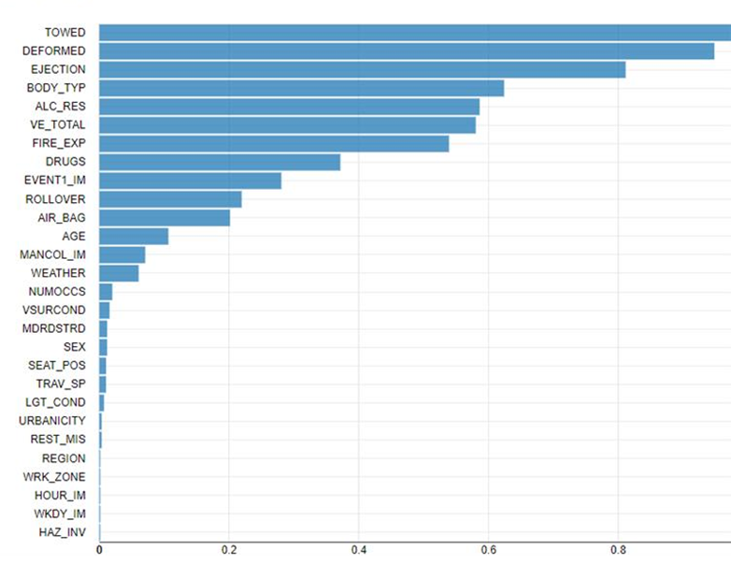
Evaluation – Variable Importance

Slide 24

Deployment
Predicting the degree of injuries incurred by a passenger in a car accident may not have much practical utility on its own.
A true understanding of the crash-related elements that might raise (or decrease) the degree of injury risk.
A deeper review of the prediction models can help with the initial identification of traffic safety-related issues.
The models reflect the mathematical link between crash-related risk variables and injury severity levels.
A systematic investigation of these correlations can indicate the relative relevance of these factors.

Slide 25
CONCLUSION
DTSC seeks to provide its clients with greater insights into the crash reporting data
Data understanding - DTSC reviewed the NHTSA CRSS crash report database for relevant tables relating to vehicle, person, accident report, and distractions
Data preparation - The columns were filtered down to relevant variables. Unknown/Not reported values were taken off. Values of some attributes were grouped together.
Modeling and Evaluation - with the input data cleaned, DTSC compared several models as seen in the evaluation table, yielding a peak prediction accuracy of 75.2% in predicting injury severity.
Deployment – passengers should take the safety precautions and should find ways to reduce the use of drugs or alcohol while traveling.

Slide 26
The end

